Slide 1
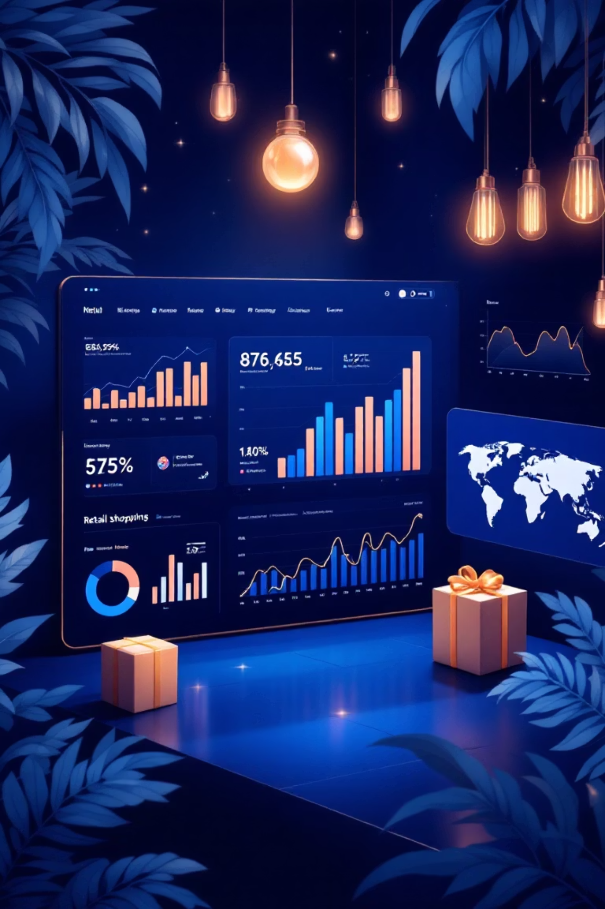
Customer Shopping Trend Analysis
A comprehensive analysis of 3,900 customer transactions to uncover shopping behaviors, identify high-value segments, and drive data-driven marketing strategies.

Slide 2

Project Overview
Dataset
Key Objectives
This report presents a detailed analysis of customer shopping behavior using transactional data from 3,900 purchases across multiple product categories.
Identify high-value customer segments
Uncover seasonal buying trends
Analyze factors influencing purchasing decisions
The analysis aims to support data-driven decision-making in marketing, product planning, and customer retention strategies.
Optimize marketing and retention strategies

Slide 3
Dataset Summary
3,900
18
37
Total Transactions
Data Columns
Missing Values
Comprehensive purchase records analyzed
Rich feature set for deep analysis
Only in Review Rating column
Customer Demographics
Purchase Details
Shopping Behavior
Age, Gender, Location, Subscription Status
Item Purchased, Category, Purchase Amount, Season, Size, Color
Discount Applied, Previous Purchases, Frequency, Review Rating, Shipping Type

Slide 4
Data Preparation & Cleaning
We began with comprehensive data preparation and cleaning in Python to ensure data quality and consistency for analysis.
01
02
Data Loading & Exploration
Missing Data Handling
Imported dataset using Pandas. Used df.info() to check structure and df.describe() for summary statistics.
Checked for null values and imputed missing values in Review Rating column using median rating of each product category.
03
04
Column Standardization
Feature Engineering
Renamed columns to snake case for better readability and documentation.
Created age_group and purchase_frequency_days columns using customer age and purchase data.
05
06
Data Consistency Check
Database Integration
Verified if discount_applied and promo_code_used were redundant; dropped promo_code_used.
Connected Python script to PostgreSQL and loaded cleaned DataFrame for SQL analysis.

Slide 5
SQL Analysis: Key Business Questions
We performed structured analysis in SQL to answer critical business questions and extract actionable insights from the cleaned dataset.
1
2
3
Revenue by Gender
High-Spending Discount Users
Top-Rated Products
Compared total revenue generated by male vs. female customers
Found products with highest average review ratings
Identified customers who used discounts but still spent above average
4
5
Shipping Type Comparison
Subscriber Analysis
Compared purchase amounts between Standard and Express shipping
Compared average spend and total revenue across subscription status

Slide 6



Customer Segmentation Insights
Key Finding
Customers with more than 5 purchases show significantly higher subscription rates, indicating strong correlation between purchase frequency and loyalty program adoption.
Loyal Customers
Highest purchase frequency and lifetime value
Returning Customers
Multiple purchases, building relationship
New Customers
First-time buyers, growth opportunity
Customers were classified into three segments based on purchase history, enabling targeted retention and growth strategies for each group.

Slide 7
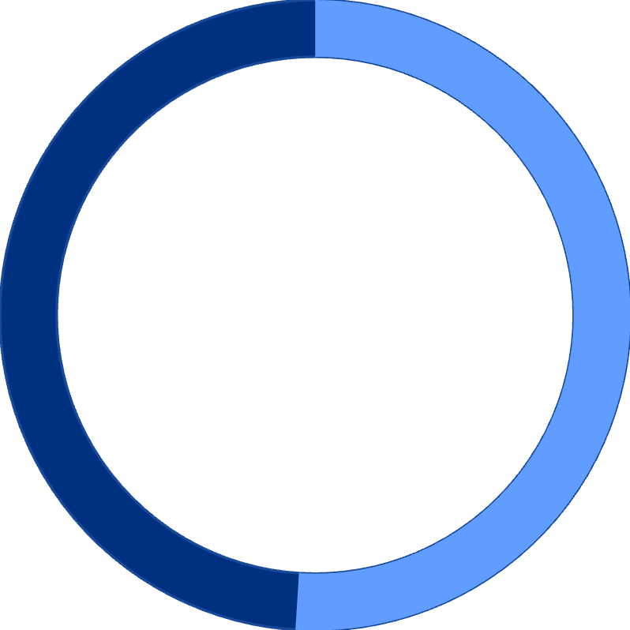
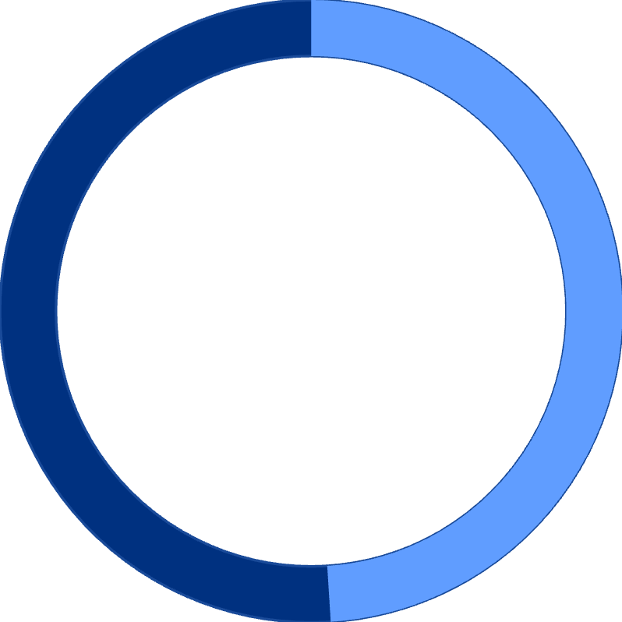
Revenue Analysis by Demographics
51%
49%
Male Customers
Female Customers
Slightly higher revenue contribution
Nearly equal revenue share
Age Group Revenue Distribution
Revenue contribution varies significantly across age groups, with middle-aged customers (35-54) representing the highest-value segment. Young adults (18-34) show strong growth potential, while senior customers (55+) demonstrate consistent purchasing patterns.

Slide 8
Product & Discount Insights
Top-Rated Products
Discount-Dependent Products
Five products achieved the highest average review ratings, indicating exceptional customer satisfaction and quality perception.
Five products showed highest percentage of discounted purchases, revealing price sensitivity patterns.
Strategic discounting drives volume for specific items
Strong correlation between ratings and repeat purchases
Balance needed between sales boost and margin control
Opportunity to optimize promotional strategies
Top-rated items span multiple categories
Consistent positive feedback across demographics
Express Shipping Users
Subscriber Advantage
Customers choosing express shipping show higher average purchase amounts, indicating willingness to pay premium for convenience.
Subscribers demonstrate higher average spend and total revenue compared to non-subscribers, validating subscription program value.

Slide 9
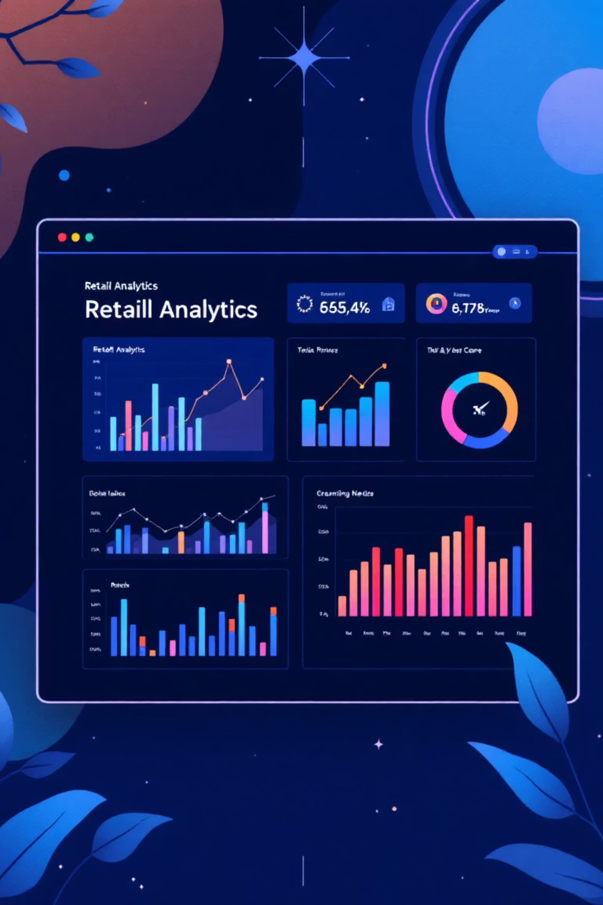



Power BI Dashboard Overview
A comprehensive Power BI dashboard was created to visualize key metrics and enable interactive exploration of customer shopping trends. The dashboard integrates all analytical findings into an intuitive interface for stakeholders.
Real-Time Metrics
Live tracking of revenue, customer segments, and purchase patterns
Interactive Filters
Drill-down capabilities by category, demographics, and time period
Actionable Insights
Visual representation of trends and opportunities for decision-making

Slide 10





Business Recommendations
Based on comprehensive analysis of 3,900 transactions, we recommend the following strategic actions to optimize revenue and customer retention.
Boost Subscriptions
Customer Loyalty Programs
Review Discount Policy
Promote exclusive benefits for subscribers. Data shows subscribers have higher average spend and lifetime value.
Reward repeat buyers to move them into the "Loyal" segment. Focus on customers with 3-5 purchases.
Balance sales boosts with margin control. Optimize discounting for price-sensitive products while protecting margins.
Product Positioning
Targeted Marketing
Highlight top-rated and best-selling products in campaigns to drive conversion and build trust.
Focus efforts on high-revenue age groups (35-54) and express-shipping users who show premium purchasing behavior.

